Slide 1
Process Discovery Using Python - Praktikum
Madhavi Shankar Junxiong Gao(Frank)
RWTH Aachen University RWTH Aachen University
madhavi.shankar@pads.rwth-aachen.de jx.gao@pads.rwth-aachen.de

Slide 2
Process Mining overview
Process mining is the missing link between model-based process analysis and data-oriented analysis techniques. Through concrete data sets and easy to use software the course provides data science knowledge that can be applied directly to analyze and improve processes in a variety of domains.
The idea of process mining is to discover, monitor and improve real processes (i.e., not assumed processes) by extracting knowledge from event logs readily available in today’s systems.
Process mining establishes links between the actual processes
and their data on the one hand and process models on the other hand.

Slide 3
Course Generic References
(Book) Van der Aalst, Wil MP. Process mining: data science in action. Springer, 2016.
(Article) Petri net https://en.wikipedia.org/wiki/Petri_net
(Article) Workflow net soundness http://mlwiki.org/index.php/Workflow_Soundness
PM4Py documentation http://pm4py.org/

Slide 4
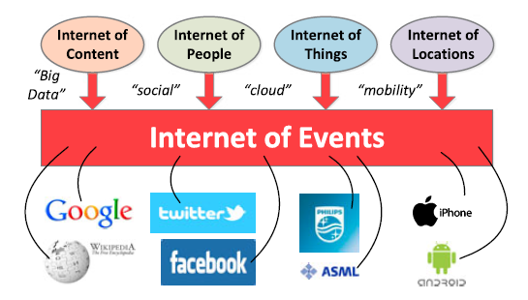
Event Data
Event data are generated from a variety of sources connected to the Internet
Sources broadly classified into 4 categories
1. The Internet of Content
2. The Internet of People
3. The Internet of Things
4. The Internet of Locations

Slide 5
Event Log
Event log can be seen as a collection of cases
A case can be seen as a trace/Sequence of events
Each event refers to a case, activity and an associated time stamp
Additional information can also be present like:
organizational group
cost
user who triggered the event
duration for which the event lasted
Sources for this can be:
Database
CSV File
Transaction Logs
ERP sytems
Message log (Middleware products)
And other data providing open API systems

Slide 6
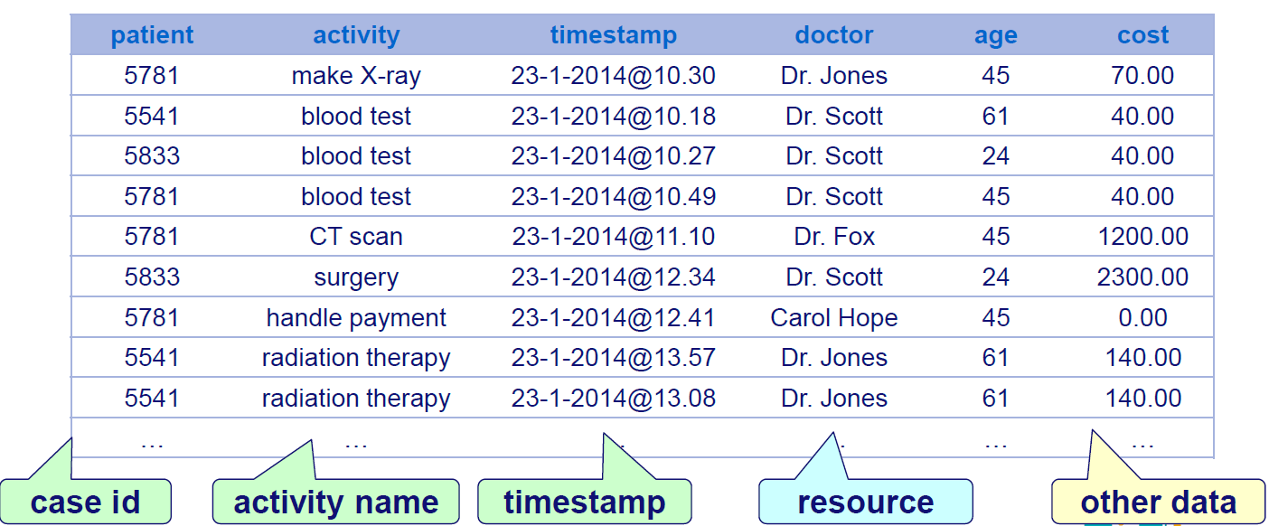
Event Log – Example

Slide 7
Event Log - Standard
Typical formats to store event logs are XES as suggested by IEEE Standards Organization
In this format all the events are grouped by Traces
XES format is the actual de-facto standard in Process Mining.
Please refer to www.xes-standard.org for detailed information on the standard

Slide 8
Process Mining Types
Discovery
A discovery technique takes an event log and produces a model without using any a-priori information. An example is the α-algorithm
Conformance
An existing process model is compared with an event log of the same process. Conformance checking
can be used to check if reality, as recorded in the log, conforms to the model and vice versa
Enhancements
The idea is to extend or improve an existing process model using information about the actual process
recorded in some event log

Slide 9
Process Mining perspectives
control-flow perspective
focuses on the control-flow, i.e., the ordering of activities. The goal of mining this perspective is to find a good characterization of all possible paths, e.g., expressed in terms of a Petri net or some other notation.
organizational perspective
focuses on information about resources hidden in the log, i.e., which actors (e.g., people, systems, roles, and departments) are involved and how are they related.
case perspective
focuses on properties of cases.
time perspective
focuses on timing and frequency of events.

Slide 10
Process Discovery
Based on an event log a process model is constructed thus capturing the behavior seen in the log.
Process Discovery techniques consider the order in which events occurred inside a trace of an event log. Each event is mapped to a step potentially represented in the process model.
A concatenation between the activity attribute value and the transition attribute value (Standard Classifier)
Some of the notations used for process models are:
Petri-nets
BPMN
UML

Slide 11
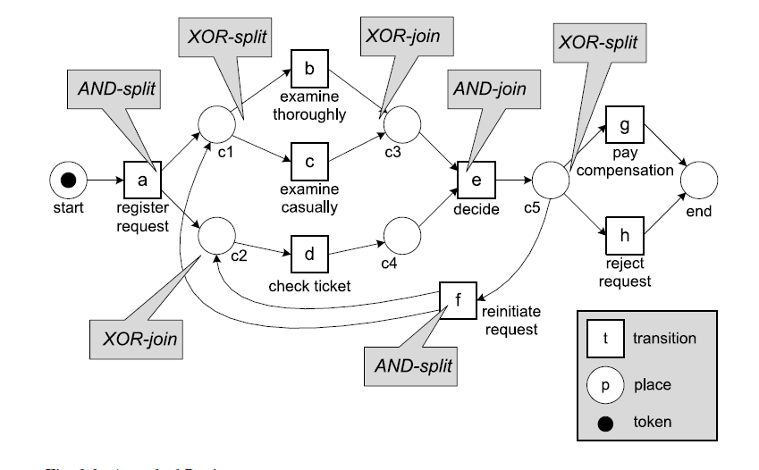
Petri Nets
Petri nets are the oldest and best investigated process modeling language allowing for the modeling of concurrency. It is a bipartite graph consisting of places and transitions
Petri Net process model consists of
Transitions: related to visible or invisible steps of the process
Places: they represent constraints of execution of the process model. They may contain tokens.
Arcs: they connect a transition to a place or a place to a transition. They may be annotated with a number that represent the weight of the arc.

Slide 12
Introduction to Process Mining Framework (ProM)
ProM (which is short for Process Mining framework) is an Open Source framework for process mining algorithms.
ProM offers a variety of plug-ins that enable you to apply the latest developments in process mining research on your own data.
Unfortunately, the use of these plug-ins is not always straightforward for new users.
It contains over 1500 Plugins catering to mutiple types of inputs/outputs and algorithms.

Slide 13
Python overview
Python is a fully-functional programming language that can do anything almost any other language can do, at comparable speeds.
Python is an interpreted language, which can save you considerable time during program development because no compilation and linking is necessary.
Capable of Threading and GPU processing
Has lot of inbuilt modules and packages for data mining

Slide 14
Python Environment to be used
Refer to the PM4PY documentation.
http://pm4py.org/
It has specific instructions based on the OS on which the installation needs to be done.
Contains detailed steps on usage of existing algorithms.

